Slide 1




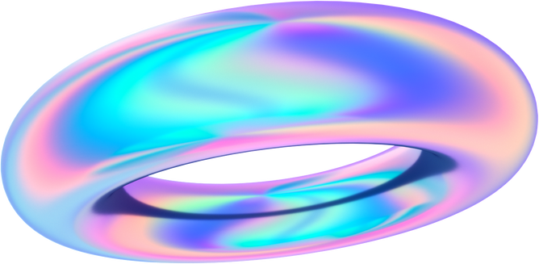
AUTOMATED RESEARCH PAPER CATEGORIZATION

Slide 2

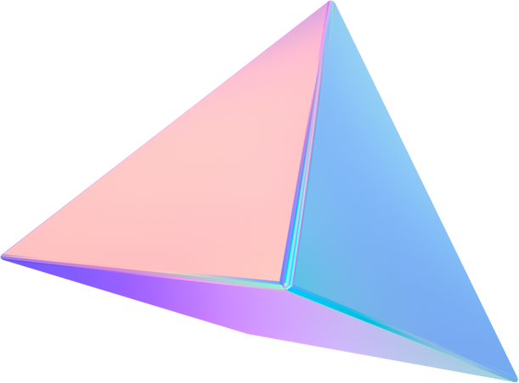
Table of contents
Applications and uses of model
Data Analysis
Research Overview
Data Visualization
Text Preprocessing
Problems faced
Briefing of other solutions tried
Conclusion

Slide 3


Importance of automated paper research paper categorization
Automated paper research categorization using machine learning offers several significant benefits, contributing to the efficiency and advancement of knowledge and accelerating the research process .
Over the last few years , automated classification of texts into predefined categories has witnessed a booming interest due to increased availability of texts online and ensuring the need to organize them according to our convenience. This method facilitates efficient retrieval of information for both researchers and students

Slide 4
Real world applications
Academic Libraries: Helps in organizing and classifying extensive collections of research papers, making it easier for users to access relevant materials.
Reviewing Literature: Facilitates the literature review process by quickly identifying and categorizing papers relevant to a specific research topic or question.
Research Databases: Enhances the structure of databases, enabling users to efficiently search and retrieve papers based on specific categories or themes.
Text Summarization: various texts classified and can be summarized by using this model
Personalized Recommendations: Machine learning algorithms can analyze a researcher’s interests based on their past work or reading habits and enables us to provide recommendations helping them discover relevant papers

Slide 5
Present Date Research
As the field is dynamic ,many new advancements have been done to categorize text using machine learning. Some of them are
Word Embeddings: Techniques like Word2Vec, GloVe, and FastText are utilized to represent words in vector space, capturing semantic relationships and improving the performance of document classification models.
Topic Modeling: Algorithms such as Latent Dirichlet Allocation (LDA) help identify the underlying topics in a collection of research papers, aiding in their categorization.
Combining predictions from multiple models using ensemble methods like bagging or boosting has been shown to enhance the overall performance of automated categorization systems.
Transfer learning, where models pretrained on a large corpus are fine-tuned for specific tasks, is gaining popularity for research paper categorization.

Slide 6

Natural Language Processing
Natural language processing (NLP) refers to the branch of computer science and more specifically, the branch of artificial intelligence concerned with giving computers the ability to understand text and spoken words in much the same way human beings can
NLP combines computational linguistics—rule-based modeling of human language—with statistical, machine learning, and deep learning models. Together, these technologies enable computers to process human language in the form of text or voice data and to ‘understand’ its full meaning, complete with the speaker or writer’s intent and sentiment.

Slide 7
Some common techniques used in NLP include Tokenization, Part of speech tagging, Sentiment analysis , Machine translation , Text classification
Human language is filled with many ambiguities hence several NLP tasks are required to break down human text in ways that help thecomputer make sense of what it’s ingesting.
Some of these tasks include Speech recognition, Part of speech tagging , Word sense disambiguation , Named entity recognition , Natural language generation .

Slide 8
Overview of our research
Multi-Label Classification Challenge:
The presence of 57 classes in the dataset presents a challenge for multi-label classification. Addressing this complexity requires specialized approaches to effectively model and predict instances with multiple associated labels.
Identification of Imbalanced Dataset:
Through a comprehensive understanding and analysis of the given dataset, it becomes evident that the dataset exhibits a substantial imbalance among its classes.

Slide 9
Exploratory Data Analysis
•Exploratory Data Analysis (EDA) is crucial as it uncovers patterns, identifies outliers, and provides insights into data structure, guiding data cleaning and preprocessing. It helps in making informed decisions, selecting appropriate models, and forming hypotheses for further analysis.
Training Dataset:
the training dataset consists of the following columns
1.Id : unique identifier foreach datapoint
2.Title : The title of the research paper
3.Abstract : The abstract of research paper in text form
4.Categories : Subject areas associated with each paper

Slide 10
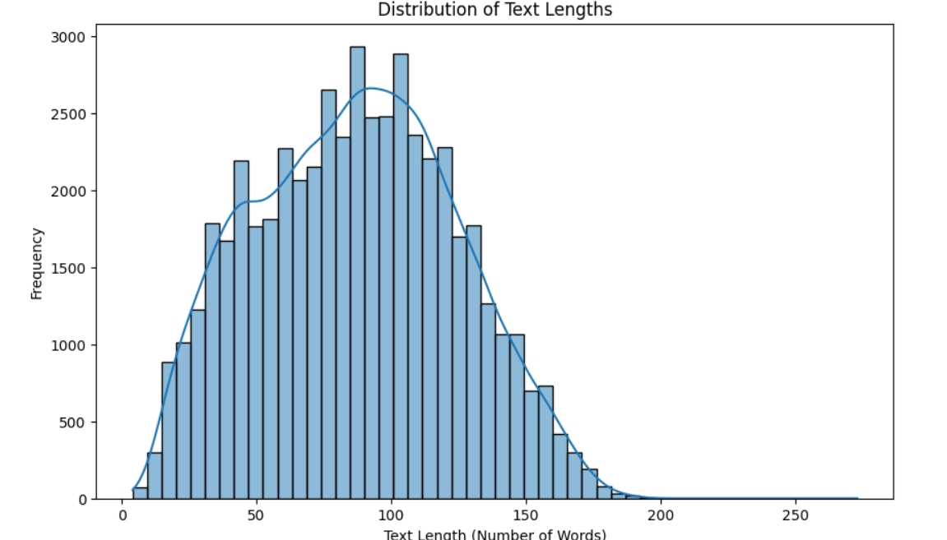
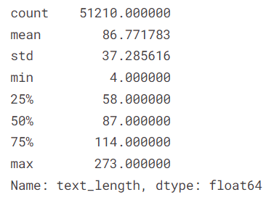
Using the libraries matplotlib and seaborn we plot some graphs to analyse and get an overview of the training data.
•Basic Statistics of text lengths
We can observe that the text length is around 200 so we kept the max length of the token as 200 .

Slide 11
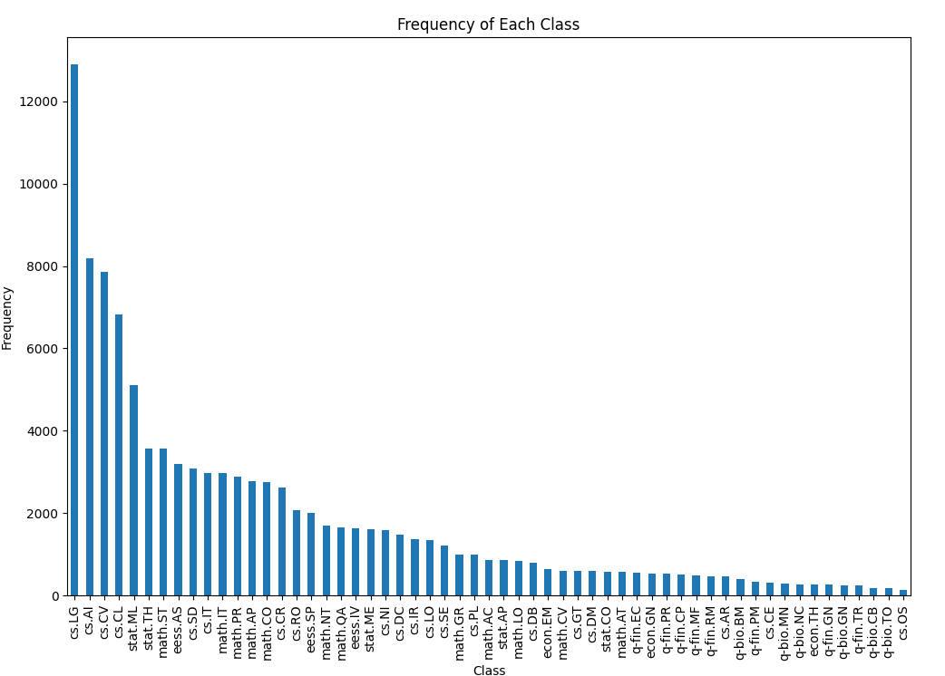
Calculating the frequency of each class
The research papers are being classified into 57 classeswith frequencies as shown

Slide 12
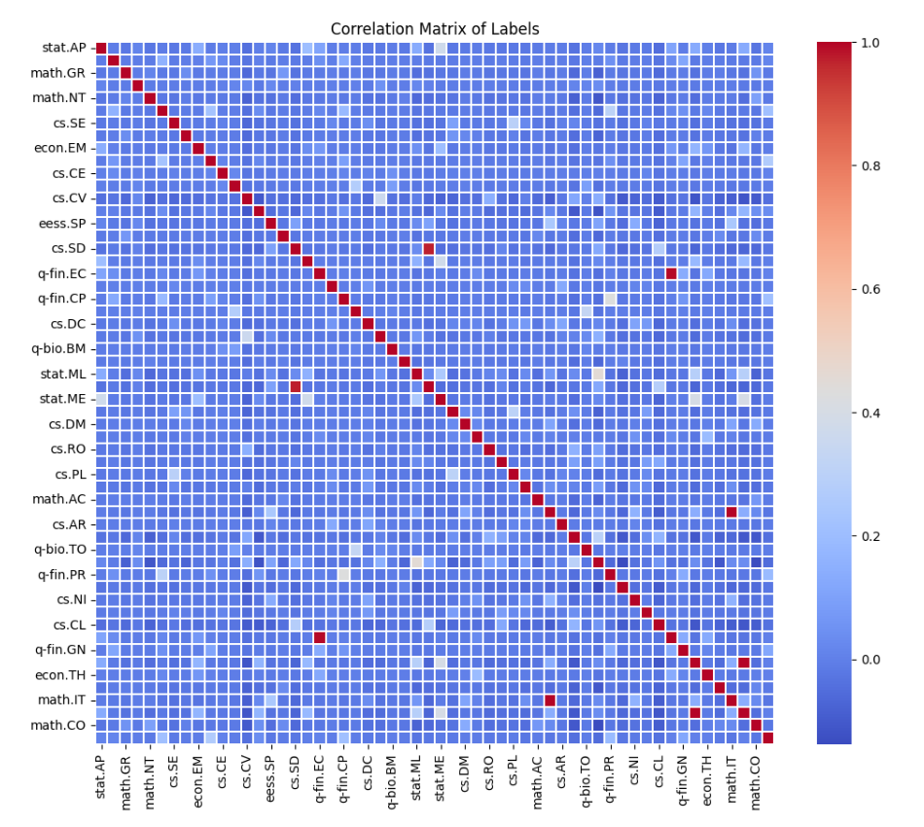
There might be categories which are related to each other creating a possibility that it can be in categorized into other classes if its presence in a class is predicted .Hence we analyze the probability using a correlation matrix for labels
# Calculate the correlation matrix for the label columns
label_correlation = df.iloc[:, 2:-1].corr()
# Plot the correlation matrix
plt.figure(figsize=(12,10)) sns.heatmap(label_correlation, cmap='coolwarm', linewidths=.1)
plt.title('Correlation Matrix of Labels')
plt.show()

Slide 13
Text Preprocessing
In any Machine learning task, cleaning or preprocessing the data is as important as model building. Text data is one of the most unstructured forms of available data and when comes to deal with Human language then it’s too complex.
Some of the important text preprocessing techniques are
1.Tokenization
2.Stemming
3.Removing Stop words

Slide 14
Stemming:
It is a process of transforming a word to its root form. It removes the suffixes to the separate the root word .
Removing Stopwords:
Stop words are very commonly used words (a, an, the, etc.) in the documents. These words do not really signify any importance as they do not help in distinguishing two documents.Hence we remove these words from the training data.
Tokenization:
Tokenization breaks text into smaller parts for easier machine analysis, helping machines understand human language. Tokenization, in the realm of Natural Language Processing (NLP) and machine learning, refers to the process of converting a sequence of text into smaller parts, known as tokens.

Slide 15
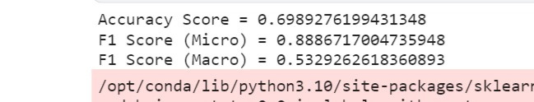
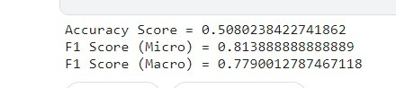
Score
On majority classes
On minority classes

Slide 16
Problems faced
The presence of multiple classes posed challenges for clustering models in our analysis. The complexity associated with handling diverse classes limited the effectiveness of traditional clustering approaches.
The significant imbalance in the dataset led to a situation where the model predominantly focused on the majority class. Additionally, the slow generation and data augmentation processes for minority classes contributed to oversampling issues, hindering the overall model performance.

Slide 17
Briefing of other solutions tried
KNN or Hierarchial clustering
LSTM
Transformers
RobertA and BERT
SciBERT
Feauturing Data
Class Imbalance
Assess metrics independently for both minority and majority classes.

Slide 18
First Idea was to solve using KNN or Heirarchial Clustering
KNN
First we tried using KNN algorithm
K-Nearest Neighbors (KNN) is a supervised machine learning algorithm for classification and regression. It functions as a voting system, assigning a new data point's class label based on the majority class among its 'k' nearest neighbors in the feature space.
We experimented with KNN, but its performance was suboptimal. The model struggled with the multitude of available categories, and some data instances were associated with more than two classes, leading to its failure. As a result, we explored alternative models.

Slide 19


Hierarchial Clustering
Hierarchical clustering is an unsupervised learning method for clustering data points. The algorithm builds clusters by measuring the dissimilarities between data.
In this algorithm, we develop the hierarchy of clusters in the form of a tree, and this tree-shaped structure is known as the dendrogram.
The hierarchical clustering technique has two approaches:
Agglomerative: Agglomerative is a bottom-up approach, in which the algorithm starts with taking all data points as single clusters and merging them until one cluster is left.
Divisive: Divisive algorithm is the reverse of the agglomerative algorithm as it is a top-down approach.

Slide 20
LSTM
LSTM is a type of recurrent neural network (RNN) designed for capturing long-term dependencies in sequential data. Using specialized memory cells and gating mechanisms, LSTMs excel in tasks like natural language processing, speech recognition, and time series prediction by effectively learning and retaining patterns in sequences.
Despite having a large dataset, the accuracy of LSTMs was compromised, suggesting that simply having a substantial amount of data does not guarantee optimal performance.

Slide 21
Transformers
Transformers differ from conventional recurrent neural networks by employing an attention mechanism to concurrently process input data. This enables them to more efficiently capture long-range dependencies
Optimizing results when fine-tuning pre-trained transformers for specific tasks is not guaranteed. The process of tuning hyperparameters and adjusting the pre-trained model to a new task can be intricate and often demands extensive experimentation.

Slide 22
Implementing BERT and fine-tuned RobertA
BERT has been widely used as a pretrained transformer-based model innumerous natural language processing projects . As a transformer-based model, BERT has been applied in various of natural language processing areas, which contain sentiment analysis , machine translation, and question answering . RobertA is a state-of-the-art natural language processing model that has excelled on several challenges. Our goal was to take advantage of RobertA's capacity to precisely capture contextual and semantic features in the text input.
We evaluated the effectiveness of the BERT and RobertA models in comparison to a number of baseline models, such as CNN, LSTM.

Slide 23
BERT is able to learn a variety of linguistic correlations and patterns since it is trained on a vast corpus of text data
In contrast, RobertA is a BERT version that uses a larger corpus and a different pre-training job.
Fine-tuning in deep learning is a form of transfer learning. It involves taking a pre-trained model, which has been trained on a large dataset for a general task such as image recognition or natural language understanding, and making minor adjustments to its internal parameters. The goal is to optimize the model’s performance on a new, related task without starting the training process from scratch.
Fine-tuning offers several distinct advantages that have made it a popular technique in the field of machine learning such as efficiency, improved performance and data efficiency.

Slide 24
step-by-step approach to effectively fine-tuning a model:
After selecting the pre-trained model, you need to make modifications to the model’s architecture to fit the requirements of your specific task. This typically involves modifying the top layers of the model.
After selecting the pre-trained model, you need to make modifications to the model’s architecture to fit the requirements of your specific task. This typically involves modifying the top layers of the model.
Once you have adjusted the architecture and decided which layers to freeze or unfreeze, it’s time to train the modified model on your task-specific dataset.
Every task and dataset is unique, and it may require further experimentation with hyperparameters, loss functions, and other training strategies.

Slide 25
Using Scibert
Got good results using scibert.
Automated research paper classification using SciBERT involves leveraging the SciBERT model, which is a pre-trained BERT (Bidirectional Encoder Representations from Transformers) model specifically trained on scientific text. The following steps outline a general process for implementing automated research paper classification using SciBERT
Make sure you have the required libraries installed, including transformers for working with SciBERT and torch for deep learning.
Obtain a dataset of research papers with labeled categories. Preprocess the text data and tokenize it using the SciBERT tokenizer.
Fine-tune the SciBERT model on your specific research paper classification task.

Slide 26
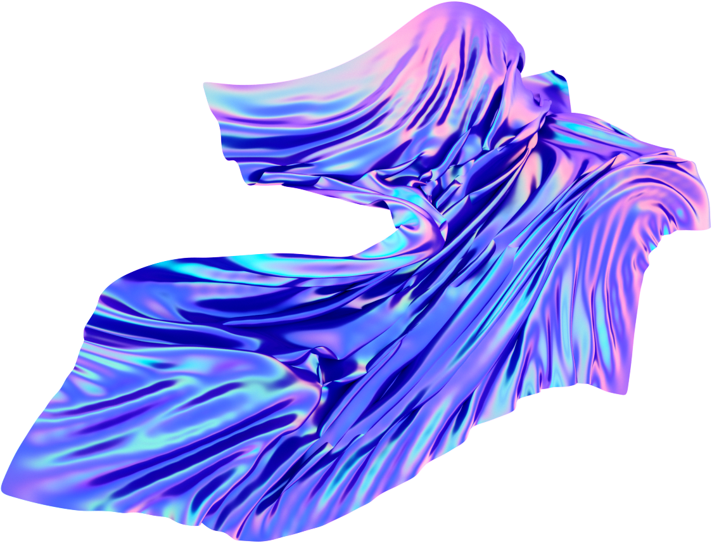
Class Imbalance
Class imbalance is prevalent in automated research paper categorization, where some categories have considerably fewer instances compared to others. This imbalance can impact the model's ability to generalize across diverse classes.
Dealing with class imbalance is crucial in research paper categorization to prevent bias towards the majority class. It ensures that the model effectively recognizes patterns in the minority classes, promoting a more balanced and accurate categorization.
Resampling techniques like undersampling and oversamling can be used to overcome this issue

Slide 27
Undersampling: Decrease the number of instances in the majority class by randomly removing instances. However, this may lead to information loss, so it should be done carefully.
Procedure:
Randomly select instances from the majority class until the desired balance is achieved.
This method helps reduce the training time, as the model has fewer instances to process.
Considerations:
Undersampling can lead to information loss, as some potentially relevant instances from the majority class are discarded.
It is crucial to carefully select the instances to be removed, as removing informative instances may negatively impact the model's performance.

Slide 28
Oversampling: Increase the number of instances in the minority class by duplicating or generating synthetic samples. Techniques like SMOTE (Synthetic Minority Over-sampling Technique) create synthetic examples to balance the class distribution.
Procedure:
Duplication: Randomly duplicate instances from the minority class until the desired balance is achieved.
Synthetic Sample Generation: Techniques like SMOTE (Synthetic Minority Over-sampling Technique) create synthetic instances by interpolating between existing minority class instances.
Considerations:
Oversampling helps the model focus on the minority class by providing more examples, potentially improving its ability to generalize patterns in the minority class.
Care should be taken to avoid overfitting, especially when duplicating instances, as it may lead to the model memorizing the training data.

Slide 29
Use the trained model for classifying new research papers.
This is a basic outline, and we might need to adapt it to your specific use case, including handling class imbalances, optimizing hyperparameters, and evaluating the model's performance.

Slide 30
One hot vector transformation
Upon utilizing the one-hot vector transformation initially, the BERT score reached 0.58. This score acts as a numerical indicator, reflecting the alignment between the model's predictions and the actual classes in the dataset.
A BERT score of 0.58 suggests a moderate level of agreement, indicating a reasonable correspondence between the predicted labels and the true classes. To enhance the model's predictive capabilities and potentially achieve more precise classification outcomes, further analysis and exploration of fine-tuning approaches can be pursued.

Slide 31
From the above plot of class frequencies , We can observe that some classes have relatively higher frequencies than the others.
There are some classes which have less frequency it can impact the impact the prediction because we are having a deficit of training data for those classes hence we need to separate them
According to our convenience we set the frequency threshold to 600 and all the classes with frequency less than the threshold are considered to be minority classes.
['q-bio.GN','q-fin.TR','q-bio.NC','q-fin.MF','q-fin.PM','cs.CE','q- bio.MN','math.AT','stat.CO','q-fin.EC','cs.OS','q-fin.CP','q-bio.CB','q-bio.BM','cs.DM','cs.GT','cs.AR','q-bio.TO','q-fin.PR','econ.GN','q-fin.GN','econ.TH','q-fin.RM']
Then class weights are calculated for each class and they are normalized to make them sum upto 1.

Slide 32
Tried using weight tensors custom loss
As part of our efforts to enhance model performance, we explored the use of weight tensors. This involved assigning specific weights to different classes through custom weight tensors. The intention was to address the challenges posed by class imbalance, directing the model to prioritize underrepresented classes and improve overall classification accuracy.
In tandem with weight tensors, we implemented a custom loss function tailored to the specific requirements of our classification task. This custom loss function aimed to optimize the model by adapting the optimization process to the unique demands of our dataset. Through these dual strategies, we engaged in experiments to fine-tune the model, with the overarching goal of improving its predictive capabilities.

Slide 33
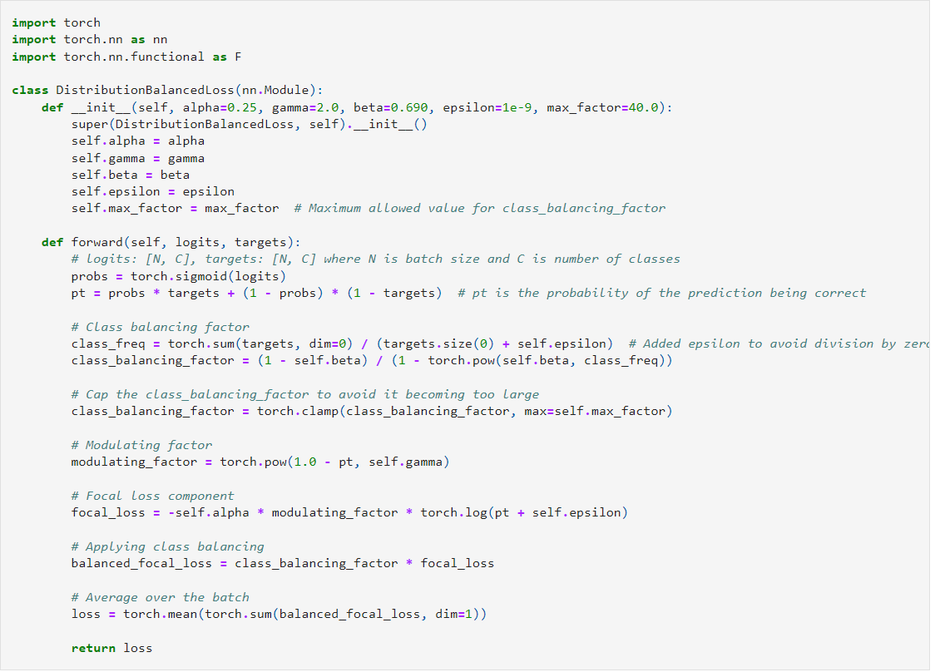

Slide 34
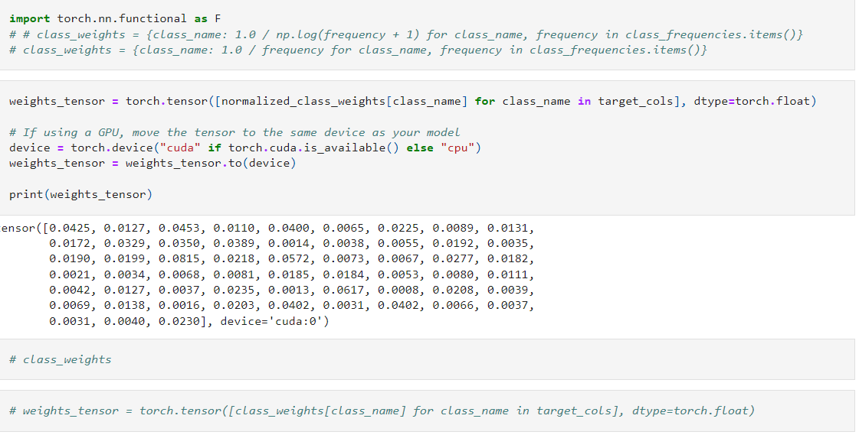

Slide 35
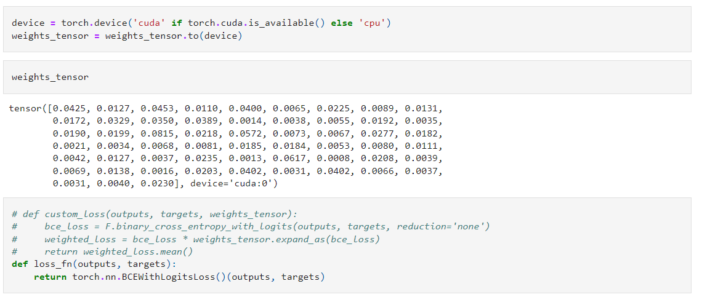

Slide 36
Tried DB loss
As part of our endeavors to enhance model performance, we incorporated the DaviBert (DB) loss function. Specifically designed for transformer-based models like BERT, this loss function is tailored to optimize the learning process, with a keen focus on addressing challenges associated with class imbalance.
By integrating the DB loss, our primary goal was to leverage its advantages in mitigating issues linked to imbalanced datasets. The aim was to potentially enhance both model accuracy and robustness by utilizing the specialized optimization criteria provided by the DaviBert loss.

Slide 37
Training just on minority classes
In addressing class imbalance, our strategy involved conducting dedicated training sessions exclusively for the minority classes. This focused training aimed to provide the model with heightened exposure to and emphasis on the underrepresented categories.
The primary objective of concentrating training efforts solely on the minority classes was to augment the model's capacity to recognize patterns and make precise predictions for these less frequent yet crucial classes present in the dataset.
This strategic focus aligns with the overarching goal of mitigating class imbalance. By enhancing the model's performance, especially in handling instances from the minority classes, we aimed to improve its overall effectiveness in dealing with imbalanced datasets.

Slide 38
Adding custom layers after scibert
Extending SciBERT involves integrating custom layers to tailor the model for specific tasks, adapting its architecture beyond the original design.
Begin by loading the pre-trained SciBERT model. This ensures you have the foundational transformer-based model for your specific domain.
Identify and define the custom layers you want to add after SciBERT.
Incorporate the custom layers into the SciBERT architecture. This extension involves appending your custom layers to the SciBERT model, creating a seamless integration of domain-specific components.
If applicable, train or fine-tune the extended model on your task-specific data.
Assess the performance of the extended model on validation or test datasets.
Fine-tune hyperparameters such as learning rates and regularization terms to optimize the extended model's performance.
Iterate through the steps, making adjustments as needed.

Slide 39
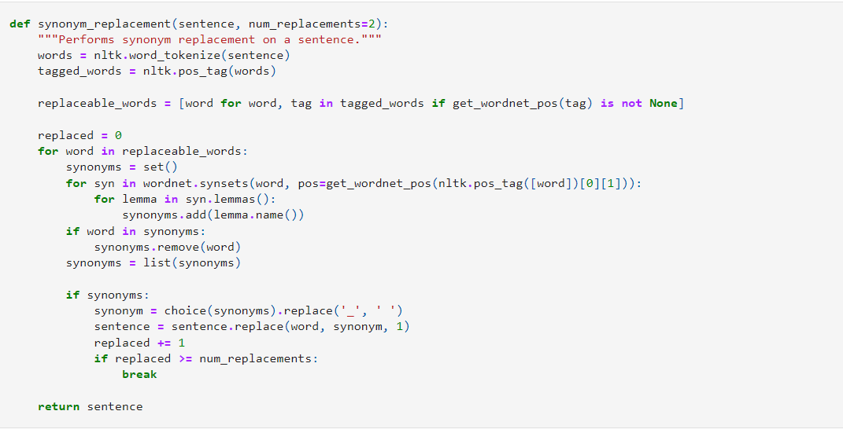
Augumentation

Slide 40
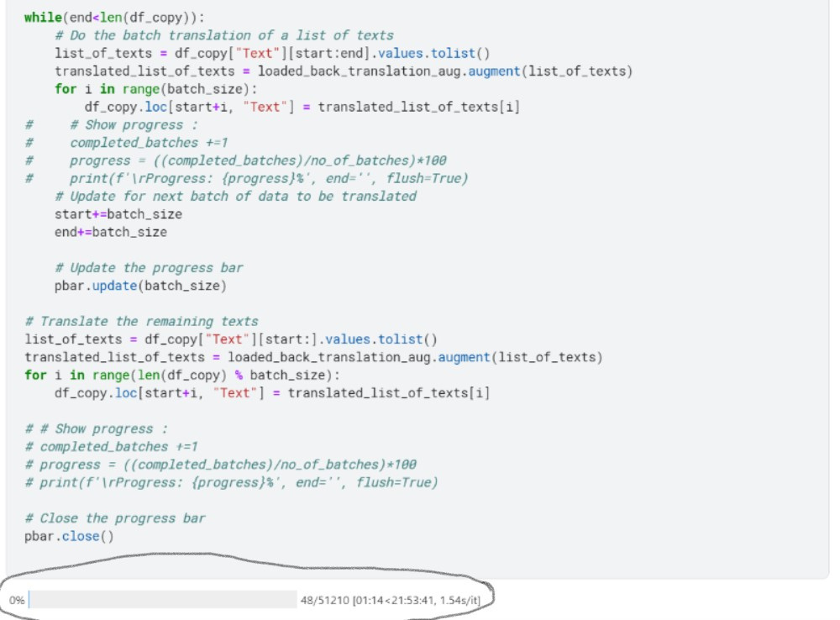

Slide 41
Conclusion
In conclusion, the journey through automated research paper categorization using machine learning has illuminated a transformative path for the scholarly community. By harnessing the capabilities of machine learning, we are paving the way for a more efficient and streamlined approach to handling the ever-expanding volume of research literature.
Our exploration has underscored the potential of machine learning models to decipher the complexities of research papers, offering a novel solution to the challenges posed by information overload. The ability to automatically categorize papers into specific topics or domains not only saves valuable time for researchers but also facilitates more targeted and insightful literature reviews. Looking ahead, the continuous evolution of machine learning techniques presents an exciting landscape for refinement and improvement.

